Slide 1
Riding the Tiger of Higher Education Reform in Asia Pacific: Where are We Heading? SEAMEO Confrerence on Higher Education Ho Chi Minh City, Vietnam
Professor Philip Hallinger
Joseph Lau Chair Professor of Leadership and Change,
Hong Kong Institute of Education
hallinger@gmail.com
www.philiphallinger.com

Slide 2
Riding the Tiger of Higher Education Reform in Asia Pacific: Where are We Heading? SEAMEO Conference on Higher Education Leadership Ho Chi Minh City, Vietnam June 2012
Professor Philip Hallinger
Joseph Lau Chair Professor of Leadership and Change
Hong Kong Institute of Education
hallinger@gmail.com
www.philiphallinger.com

Slide 3
Welcome!
Notes:
Leadership Coaching for Innovation and Performance
© 2009 Dr. Philip Hallinger
3

Slide 4
Driving Change in Higher Education
With higher education recognized as a vital tool to stimulate economic growth in the [ASEAN] region, efforts to raise standards and encourage collaboration are gaining pace. . . Raising standards at higher education institutions across Asean. . . is considered a key aspect of the effort to train the skilled workforce necessary for economic development.
A recent World Bank report found that while higher education participation in less prosperous East Asian countries has increased sharply in recent decades, the number of graduates is still too low for countries such as Cambodia and Vietnam. . . [which] are neither delivering graduates with the skills nor producing the research required to address labor market and innovation needs.
Gooch, L. ASEAN nations put education front and center. New York Times, October 31, 2012, p. 7

Slide 5
Theme: Riding the Tiger
In Asia we are riding a ‘tiger’ of change in higher education.
The ‘tiger’ is the pressure on Asian universities to gain in the race for world university rankings.
The ‘tiger’ is carrying us towards goals that may not reflect the aspirations of Asian societies, our universities, or the people that work and study in them.
Yet, climbing off the ‘tiger’ feels even more dangerous than hanging on. What should we do?

Slide 6
Presentation Objectives
To examine the emergent global emphasis on world university rankings as a driver of change in higher education.
To discuss the response of Asian universities to this trend.
To assess consequences for higher education in the region.
To explore options for charting the future direction of higher education in Asia.

Slide 7
Systemic Impact of World Rankings: Who wins, who loses?
Students & Society
Faculty
University Leaders
System Leaders
Journals
Journal Rating Agencies
World
Ranking
Org’s

Slide 8
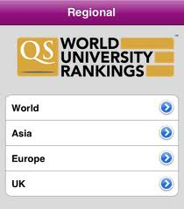
Ranking Organizations
The university ranking virus began in the USA in 1990s, spread to the UK and China, and since 2004 has turned into a global pandemic.
Different groups saw an opportunity to profit from rankings and started the race.
Who’s benefitting from the rankings race?
Billaut, J.C., Bouyssou, D., & Vicke,, P. (2010). Should you believe the Shanghai ranking?: An MCDM view. Scientometrics, 84(1), 237-263).

Slide 9
Are Rankings a Valid Quality Indicator?
Rankings are not reliable indicators of quality.
They vary widely over time and between ranking organizations.
Ranking data are not reliable (often self-reported on websites).
Florian, R. (2007). Irreproducability of the results of the Shanghai academic ranking of world universities. Scientometrics, 72(1), 25-32).

Slide 10
Validity of the Rankings Relates to Use
The rankings can offer insight into some issues such as a university’s or a nation’s research capacity (e.g., Hien, 2010).
But validity of the rankings is highly suspect for the purposes for which they are being used, such as staff performance appraisal and overall quality assessment.
Docampo, D. (2011). On using the Shanghai rankings to assess the research performance of university systems. Scientometrics, 86, 77-92.

Slide 11
Journal Rating Agencies
Riding the Tiger World university rankings rely heavily on research output assessed by journal ratings (citation impact).
Journal rating process lacks consensus on methods as well as reliability, validity & transparency.
Results are further distorted by regional emphases (e.g., ISI/USA, ERIH/Europe, ERA/Aus).
Journal rating agencies are coming under pressure (ERA in Australia; SSCI in Asia).
ISI
SSCI
ERA
SCIMAGO
ERIH
EI
ISTP
Rowbotham, J. (2011). End of an ERA: Journal rankings dropped. The Australian, 12.

Slide 12
Publishers and Journals
Riding the Tiger With norm of publish or perish, scholars feel at the mercy of journals, but the reputation of journals depends on rankings from the Rating Agencies.
Journal access and recognition by Rating Agencies is distorted by a lack of transparency and accountability in the ranking process.*
Harris, C. (2008). Ranking the management journals. Journal of Scholarly Publishing, 39(4), 373-409.
Coleman, A. (2007). Assessing the value of a journal beyond the impact factor. Journal of the American Society for Information Science and Technology, 58(8),1148-1161.

Slide 13
System Leaders Seek Top 100 Status
Riding the Tiger In Asia, inter-university competition and national pride drive the race for Top 100 status.
System leaders seek ‘Top 100’ status.
France 2 uni’s in top 20
Malaysia has a goal of 1 uni in top 50 and 3 in ytop 100 by 2020.
Holmes, R. (2011). Despite ranking changes, questions persist. University ranking watch. October 16, 2011, issue 193.
Notes:
Growing competition among universities drove interest in rankings over past decade
Regional government sought to increase the number of top 100 universities
Resulting in new policies:
RAE
Reward for performance
Publication requirements
Journal list requirements

Slide 14
Changing Higher Ed Goals in Malaysia
In its 2004 ranking of world’s top 500 universities, the Shanghai Jiao Tong University listed 66 universities from Asia-Pacific. . . but not a single one from Malaysia. Malaysia’s omission from the The Times Higher Education Supplement ranking of the world’s top 50 universities and total absence from the Shanghai Jiao Tong University’s World’s Top 500 Universities annual ranking should be the focus of serious parliamentary debate and concern. (Lim Kit Siang, Sept. 11, 2004)

Slide 15
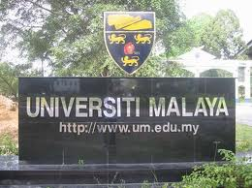
Change in Goals and Strategies
The Higher Education Ministry will recruit more international students and aggressively promote the country as an education hub. This is part of its efforts to have a local university ranked among the world's top 50 universities by 2020. Deputy Higher Education Minister Datuk Saifuddin Abdullah said in order to raise the rankings in QS WUR, there should be an increase an increase in research and development, international collaboration network and high-impact publications. (New Straits Times, 2012)

Slide 16
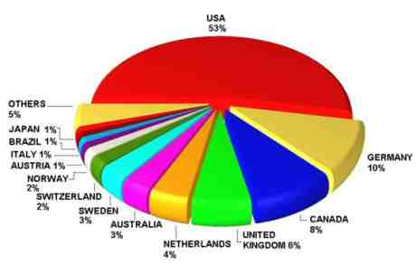
How many Uni’s can fit in top 100?
Should policies designed to achieve top 100 status be applied to all universities regardless of their mission?
What are the effects on universities, education systems, knowledge production, students and societies?
Is the ‘tiger’ carrying us towards higher quality?

Slide 17
Race is Not on a Level Playing Field
The ‘metrics’ for measuring success in the race reflect Western values.
‘Western’ universities have a head start in the race in terms of human and financial resources.
Are academic leaders making choices that disadvantage their universities, staff, students and societies?
Hallinger, P. (2011). Accelerating development of a knowledge base for educational leadership and management in East Asia. School Leadership and Management, 31(4), 305-320.

Slide 18
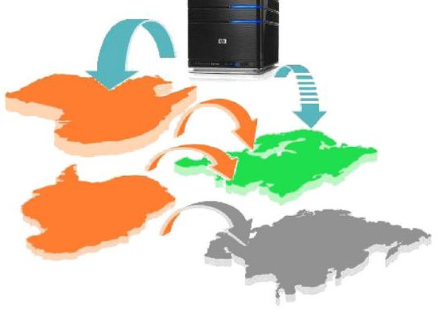
Global ‘Virus’ Spreading in East Asia
China
Hong Kong
Singapore
Taiwan
Malaysia
Thailand
Vietnam

Slide 19
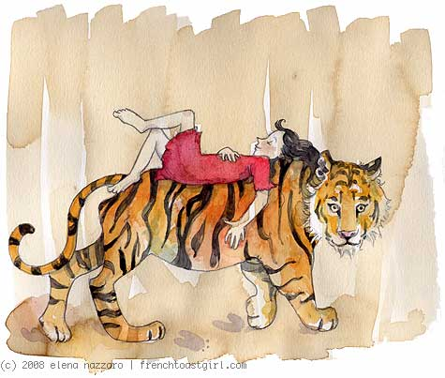
Impact of Reward for Publication
In China, the system is focused entirely on a single dimension for judging quality — the Impact Factor. . . This may result in distortion and corruption of the publication system. . . Franck warned that when scientists’ success depends too heavily on citation counts, they will find ways to game the system. . . There are many ways of accumulating citations that have little to do with scientific value.”
http://scholarlykitchen.sspnet.org

Slide 20
‘Embracing the Tiger’ in China What Gets Measured, Gets Done
Performance Rewards
China Context
Indexed in ISTP $92
Indexed in EI $275
Impact factor < 1 $306
1 ≥ IF < 3 $458
3 ≥ IF < 5 $611
5 ≥ IF < 10 $764
IF ≥ 10 $2,139
Science/Nature $30,562
For most scientists, publishing an article in a prestigious journal is likely to be recognized and rewarded with attention from one’s peers.
In China, however, scientists are also rewarded with cash, and the more prestigious the journal, the larger the sum, according to a new paper published in the April 2011 issue of Learned Publishing.

Slide 21
Unanticipated Consequences of Well-Intentioned ‘Pay for Performance’ Policies
Rampant plagiarism
Explosion of low-quality journals
Declining quality of research
Reduced or misinformed impact of research findings
Use of influence to ensure or deter publication
Erratic publication
Undeserved promotion
Systemic corruption
Wasted resources

Slide 22
University Leadership Becomes Distorted
Riding the Tiger University leaders reshape institutional priorities or risk loss of funding and legitimacy.
Responses distort institutional policies and result in realloca- tion of resources to the things that are measured in rankings.
Leaders look on helplessly, even when new KPIs are not suitable to the university’s core mission or level of the university’s or society’s development.

Slide 23
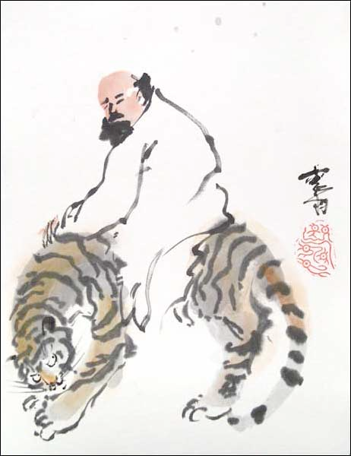
The Professoriate
Riding the Tiger Under pressure to raise research output, academic staff increase effort at ‘playing the game’ rather than towards the core mission.
Pressure to publish in specific journals becomes the priority rather than contribution to knowledge, teaching and service.

Slide 24
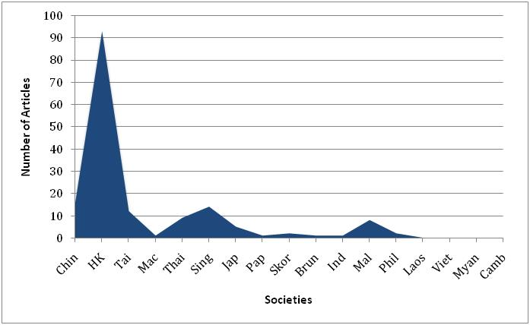
Case Example: Scholarship in Educational Management
From 2000-2012 there were 2,610 articles published in 8 core ed management journals, but only 186 came from East Asia: less than 15 per year
Most countries had no international publications
In few nations would this pattern of publication meet the standards proposed for ‘World Class Universities’ in the region

Slide 25
Impact on Teaching and Learning
Moreover, increasing the time spent on research (often low quality research) MUST come at a cost to time devoted to teaching and service.
Contrary to assertions by administrators, there is no empirical evidence to suggest a correlation between higher research output and teaching quality.
Increased Research Focus Comes at a Cost

Slide 26
Consider the Consequences
The good news is, what gets measured gets done.
The bad news is, what gets measured gets done.
Stay on the tiger’s back and starve, or climb down and be eaten. The rules emerging from the ranking game have changed the direction of university education, but not necessarily for the better.

Slide 27
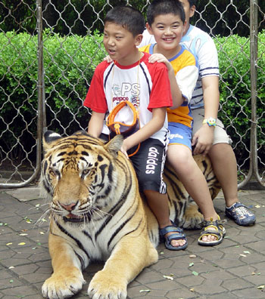
Impact on Asian Students and Society
Riding the Tiger Students suffer, especially in tier 2, 3 & 4 institutions where policies press leaders to shift the focus from teaching and service to research.
Is this what students want?
Is this what our societies want?
Are these metrics capturing what’s important?

Slide 28
The ‘Tiger’ is a Systemic Problem
Systemic problems result from interconnected issues that operate across the overall system, rather than from a specific individual, or isolated factor.
Systemic problems are difficult to solve because they require coordinated action across the system
(Wikipedia, 2011)

Slide 29
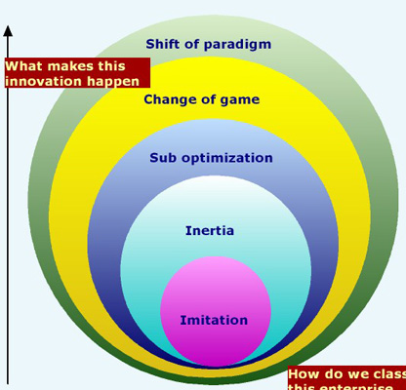
It Requires a Systemic Solution
Reward for low quality publication
Rethink purpose
Systemic problems require change to the structure, organization or policies. (Wikipedia, 2011)
Systemic solutions are difficult to initiate because of conflicting interests and lack of coordination across system parts.
Only leadership can bring about this type of change, but where will it come from?
Solutions
Nothing that we can do. ..
Change the Criteria for Ranking
Require SSCI Publication

Slide 30
Do We Need a Paradigm Shift?
“Arguing the relative merits of the scholarship happening at Cambridge, Massachusetts versus Cambridge, England is a fair debate, and even a fun pursuit. However, very few universities in developing countries can ever afford to compete with the finances available to these super-elite universities, to avail themselves of the world's who's-who of intellectual talent, and to pick and choose from cutting-edge research.
But even if they could, should they even try? Probably not, said experts at a recent forum organized by the UNESCO, the Institutional Management of Higher Education and the World Bank. Rather than trying to "keep up with the Joneses" and conforming to the prevailing mono-culture approach to higher education by funneling scarce public funds to create flagship universities, governments would be advised to ignore the rankings altogether.
The Nation. (2011, July 29). Do university rankings truly measure up? The Nation, p. 11.

Slide 31
Forces Impeding a Paradigm Shift
We live in an age of metrics, and measurement-driven accountability.
The ranking companies and publishers want to sell newspapers and adverts.
The winners (the Top 100) are leading universities and have a stake in the current system.

Slide 32
This ‘system’ is by accident, not by design
This high stakes system is in the hands of people selling media and consulting services.
System leaders want to believe that the ‘Tiger’ is heading towards quality.
Academic leaders have a moral responsibility to do what’s right for their stakeholders.
Can we let the future of higher education to be shaped by ‘an accident’ of the free market?
Looks like this by accident, or by design?

Slide 33
An Illogical Logic
“We know far more about the features that characterize a successful [university] than we know about how a university became successful in the first place. Why, then, do we try to force [universities] that we don’t like, to resemble [universities] that we do like, by employing means that have little to do with the evolution of the kind of [universities] that we like?”
(paraphrased from Roland Barth, 1986, p. 294)

Slide 34
Leverage Points in the System
World Ranking
Companies
University Faculty
University Leaders
System Leaders
Journal Rating
Agencies

Slide 35
Leverage Points for Change
Bad News
Good News
Ranking and Rating Companies have no incentive to initiate changes to current system.
System, university and faculty leadership is fragmented and uncoordinated.
Current ‘winners’ – nations or uni’s -- have little incentive to change the game.
Multiple parts of the system need to change to achieve a better result.
Rating and Ranking Companies have no intrinsic stake in the criteria and will respond to pressure and publicity.
Other actors have a low stake in the current system’s design.
Moral leadership exercised beyond the boundaries of individual universities could create the critical mass needed to change.

Slide 36
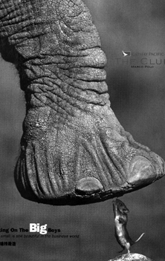
A Leadership Dilemma
“I see the negative effects but feel powerless to do anything.”
In a systemic problem, ‘I’ may be powerless, but ‘we’ are not.
Only by acting together, can ‘we’ can change the game.
This is both a choice and a moral imperative.

Slide 37
What’s Worth Fighting for Out There?*
The Middle Way is to
‘Change the Game’
The scholarly community must gain greater input and monitoring over the rules of the game.
Change the ‘Ranking Game’ to reflect the reality of university development and social contribution.
Only by cooperation can the region’s university leaders create reciprocal pressure for change on other parts of the system.
* Hargreaves & Fullan, 1998

Slide 38
Our Choice: Lead or Follow
Any top-down, one-size-fits-all approach to universities that eschews diversity is an uninspiring model for humanity. A new paradigm or "social engagement scorecard" for ranking universities across the world would instead break free of homogenised evaluation regimens and make the rankings more productive for countries struggling to improve the quality of their entire education systems.
S. Irandoust & S Calvani 2011

Slide 39
SEAMEO Higher Education Leadership Conference 2012
Dr. Philip Hallinger
Joseph Lau Chair of Leadership and Change
Asia Pacific Centre for Leadership and Change
Hong Kong Institute of Education
hallinger@gmail.com

